Slide 1
ME 165
Basic Mechanical Engineering
Lecture 06
​
Structure ​
Sadia Tasnim
Lecturer
Department of Mechanical Engineering, BUET

Slide 2
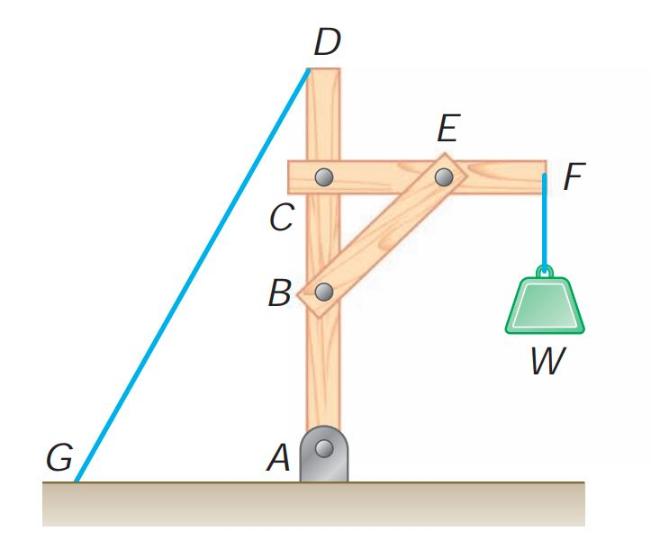
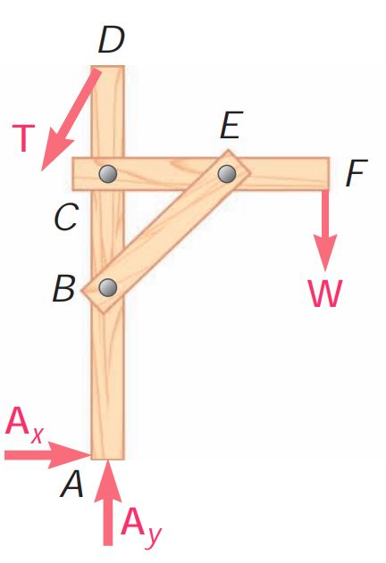
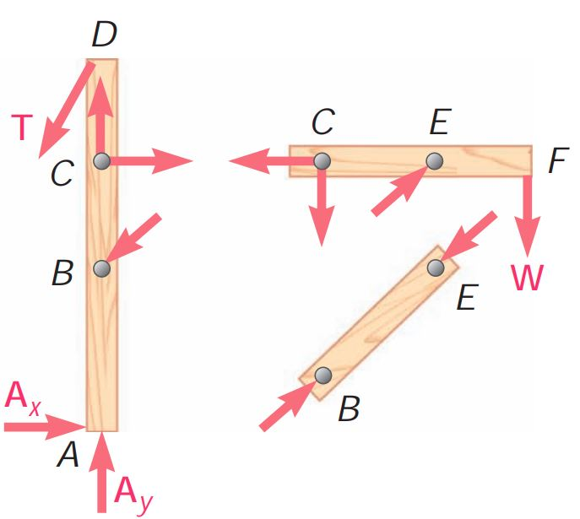
Analysis of Structures
Structure:
Consists of several connected parts or members.
Apart from the external forces acting on the structure, we have to consider internal forces that hold together the various parts of the structure.
A Structure
FBD of the structure
FBD of individual members

Slide 3
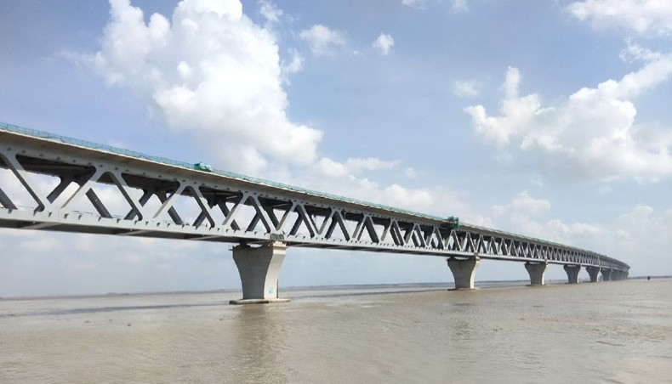
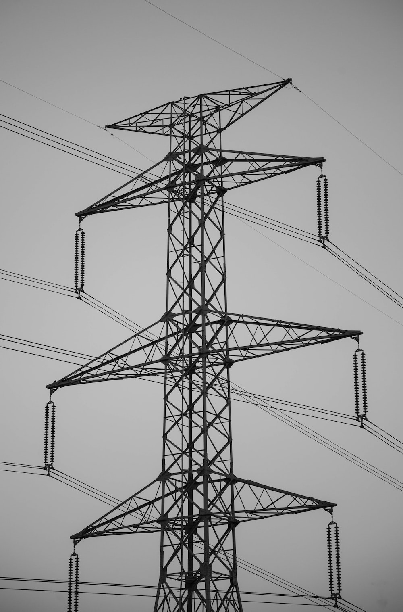
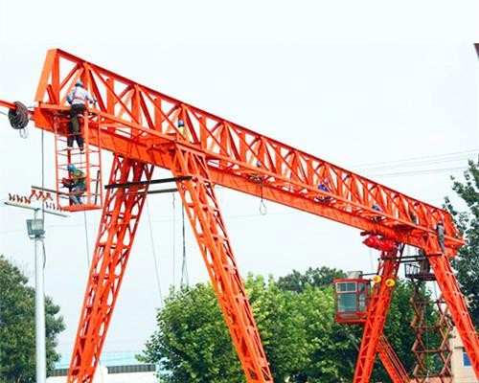
Types of Structures
Truss:

Slide 4
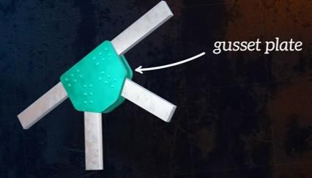
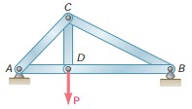

Types of Structures
Truss:
A rigid structure which is designed to support loads
Consists of exclusively of straight members
Connected at joints located at the ends of each member by pinned connection
Loads are only ever applied at the joints of the truss; but not in the middle of the member
All the members are two-force members
Stationary
Fully constrained

Slide 5
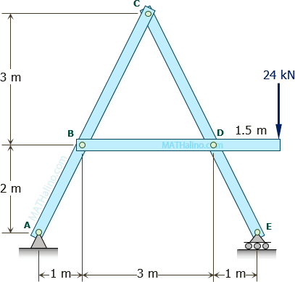
Types of Structures
Frame:
Almost all the characteristics of a truss are valid for frame. But there is extra features in frame which differentiate it from truss.
Contains at least one multi-force member i.e., a member acted upon by three or more forces which, in general, are not directed along the member
Can also have loads applied directly to its members
Not necessarily always have pin joints

Slide 6
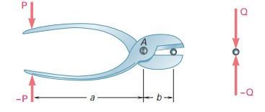
Types of Structures
Machine:
Are designed to transmit and modify loads
Have moving parts
At least one member is multi-forced member

Slide 7
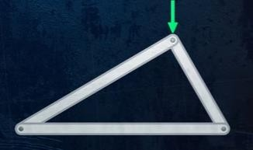
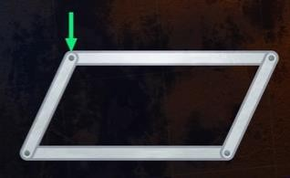
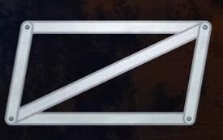
Types of Structures
Truss:
The base shape of truss is three members connected to form a triangle, a stable shape which won’t deform when loads applied to it.
(a) Stable
(b) Unstable
(C) Stable
Joining four members together does not form a stable structure. Because of the application of load, angles between members can change without any change in the length of the members.

Slide 8
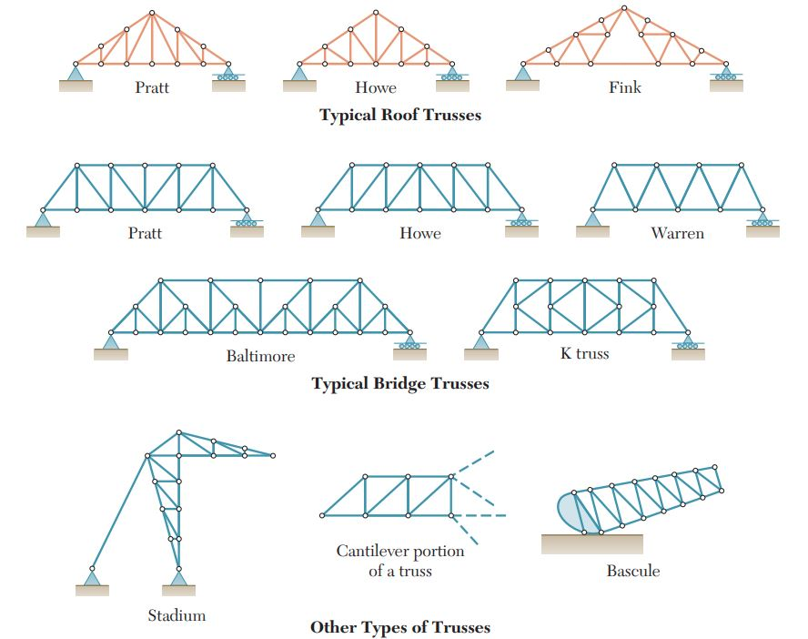
Types of Structures
Truss:

Slide 9
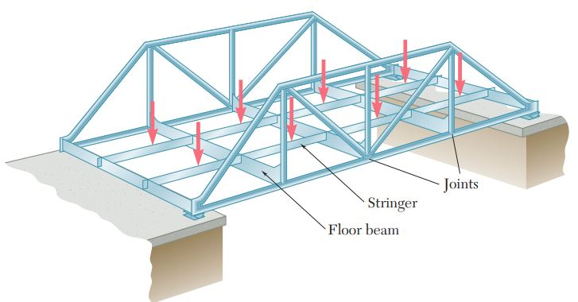
Types of Structures
Truss:

Slide 10
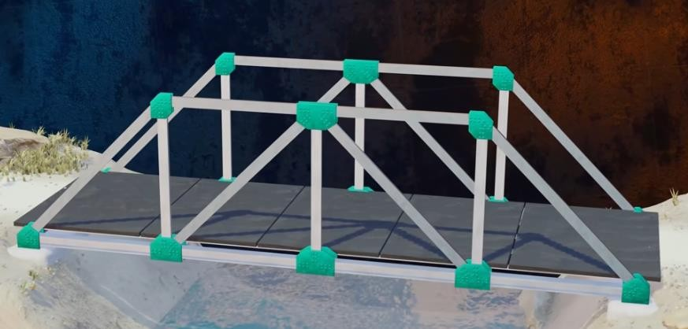
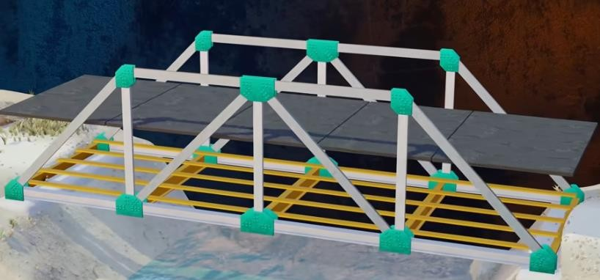
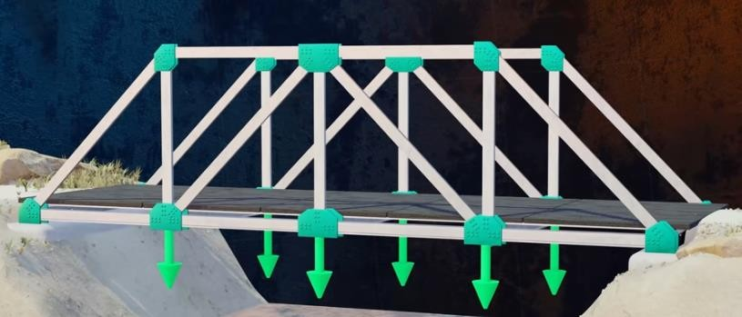
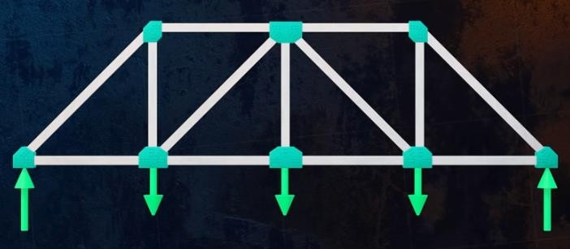
Types of Structures
Truss:

Slide 11
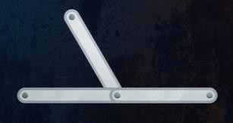
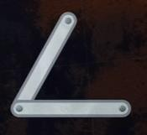
Analysis of Trusses by Method of Joints
2
Zero force members: Members don’t carry any loads at all
o 2 main configurations where we have zero force members:
When three members connected at a single joint such that
two of the members are aligned / collinear
third member makes an angle with other two
no external loads or support reactions applied to that joint
When two members connected at a joint such that
two members are not aligned / non collinear
no external loads or support reactions applied to that joint

Slide 12
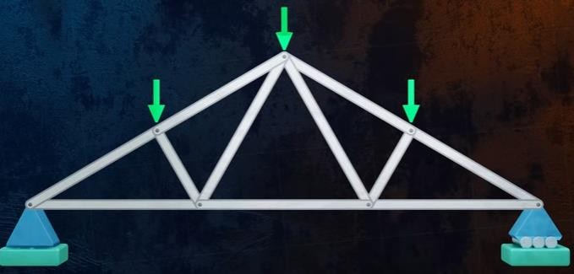
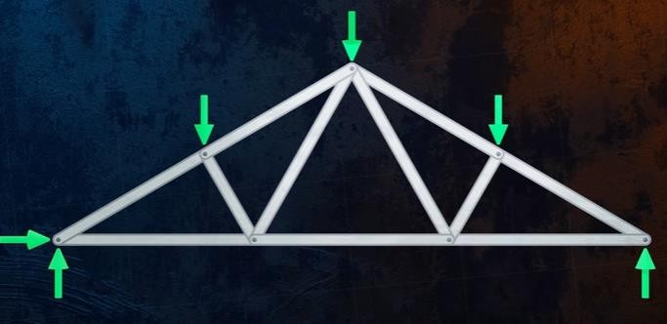
Analysis of Trusses by Method of Joints
1) Draw free body diagram of the truss and solve reaction forces.

Slide 13
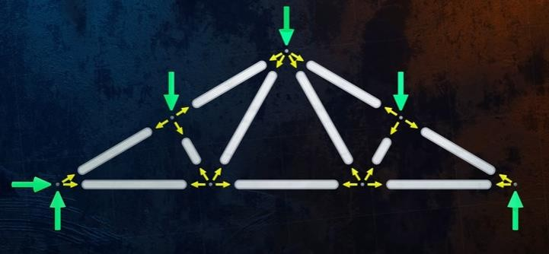

Analysis of Trusses by Method of Joints
2) Draw free body diagram of each joint and solve internal forces.
Here, we will calculate forces acting on the joint, not the forces in the member.

Slide 14
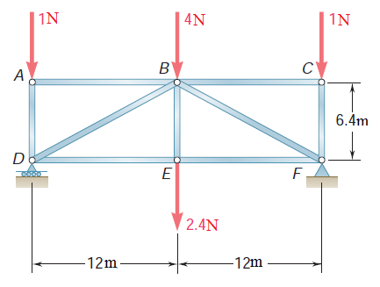
Analysis of Trusses by Method of Joints
Problem:
Using the method of joints, determine the force in each member of the truss shown. State whether each member is in tension or compression

Slide 15
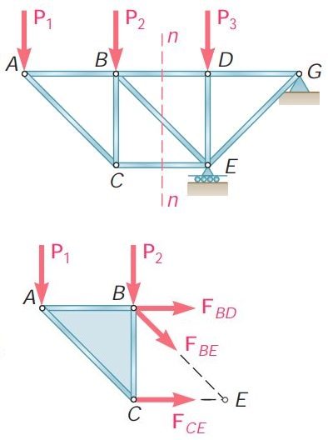
Analysis of Trusses by Method of Sections
Method of Joints is usually the best method to use when the forces in all the members of a simple truss are to be found.
Method of Sections is more effective when the force in only one member or the
forces in a very few members of a simple truss are desired.

Slide 16
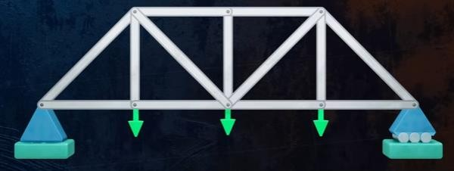
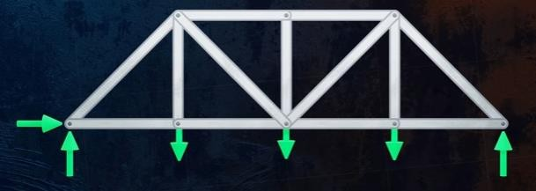
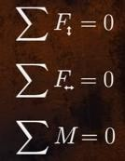
Analysis of Trusses by Method of Sections
1) Draw free body diagram of the truss and solve reaction forces.

Slide 17
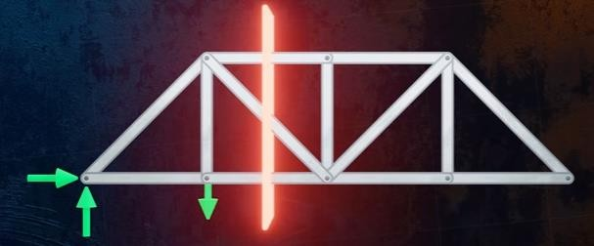
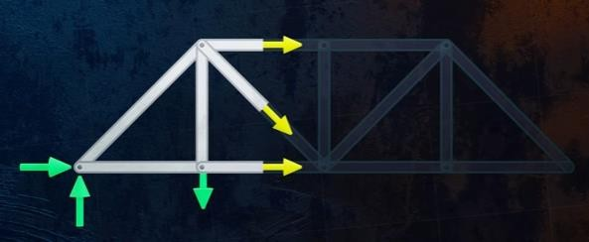
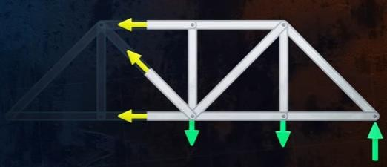
Analysis of Trusses by Method of Sections
2) Cut the truss through the members of interest and draw the internal forces
3) Apply the equilibrium equations to solve internal forces
or

Slide 18
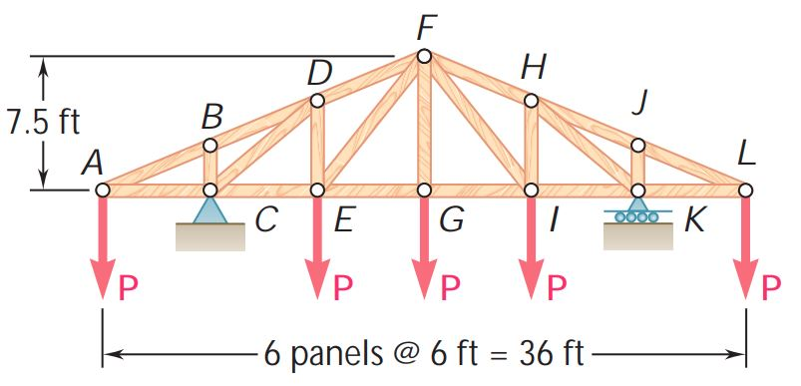
Analysis of Trusses by Method of Sections
Problem:
Determine the force in members DE and DF of the truss shown when P =20 kips

Slide 19
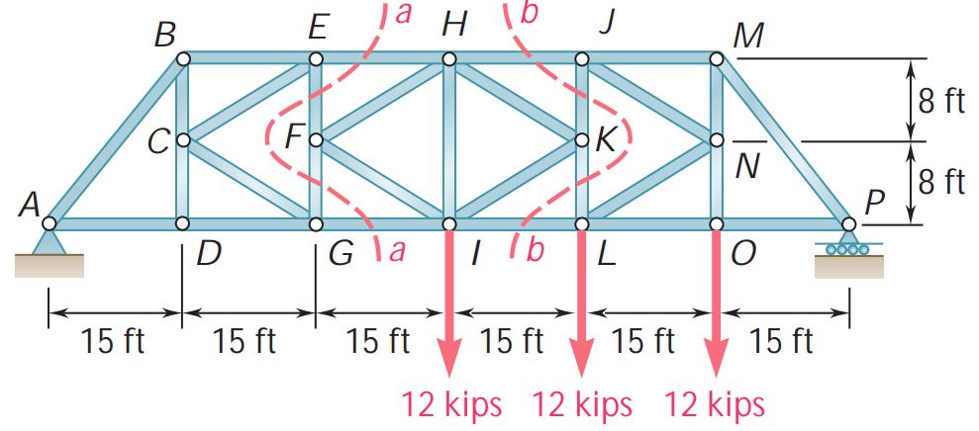
Analysis of Trusses by Method of Sections
Practice Problem:
Determine the force in members EH and GI of the truss shown.
(Hint: Use section aa)

